Slide 1

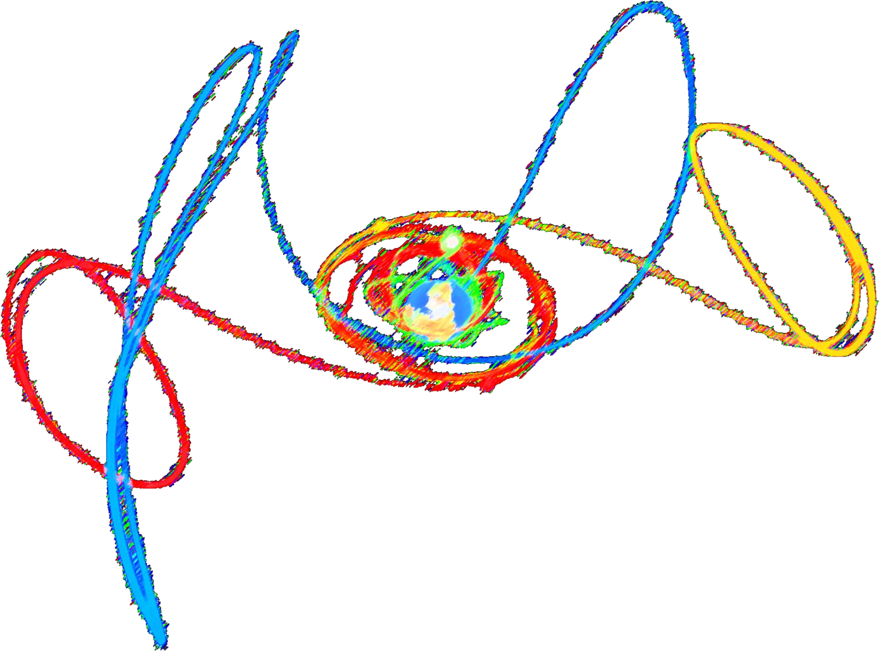
ORBITAL MECHANICS PROJECT ASSIGNMENTS
Davide Bellini, Edoardo Mensi Weingrill, Pietro Mirri, Gabriele Nuccio
Department of Aerospace Science and Technology, Politecnico di Milano
Academic year 2023/24

Slide 2
Table of contents
Assignments 1 & 2
Assignment 1: Interplanetary Explorer Mission
Mission overview
Preliminary Analysis
Grid Search
Genetic Algorithm
Mission analysis outputs
Assignment 2: Planetary Explorer Mission
Nominal Orbit Characterization
Ground Track
Orbit Propagation
Model Comparison
Model Evaluation

Slide 3
Assignment 1
INTERPLANETARY EXPLORER MISSION

Slide 4
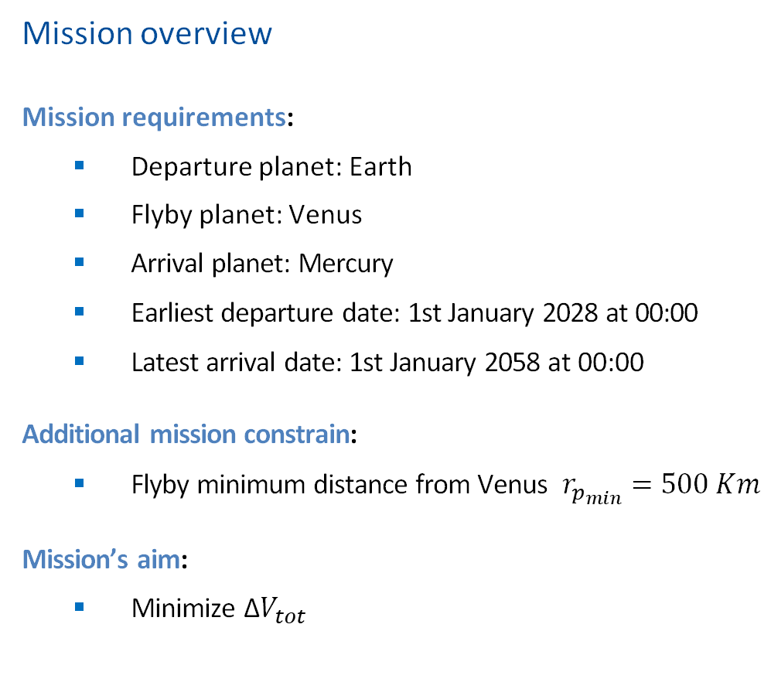
Interplanetary Explorer Mission
MISSION DESIGN
Mission overview
Mission requirements:
Departure planet: Earth
Flyby planet: Venus
Arrival planet: Mercury
Earliest departure date: 1st January 2028 at 00:00
Latest arrival date: 1st January 2058 at 00:00
Additional mission constrain:
Flyby minimum distance from Venus $r_{p_{min}}=500 Km$
Mission’s aim:
Minimize $\text{Δ}V_{tot}$
Preliminary analysis
Grid Search
Genetic algorithm 1
Optimized Genetic algorithm
Results

Slide 5
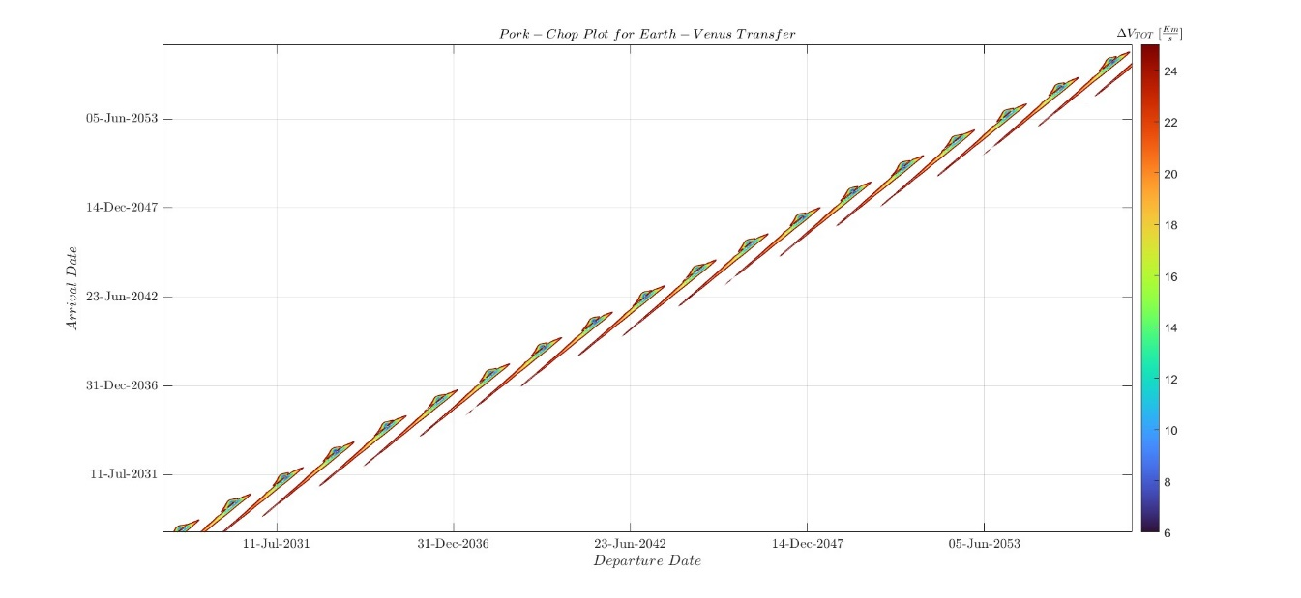
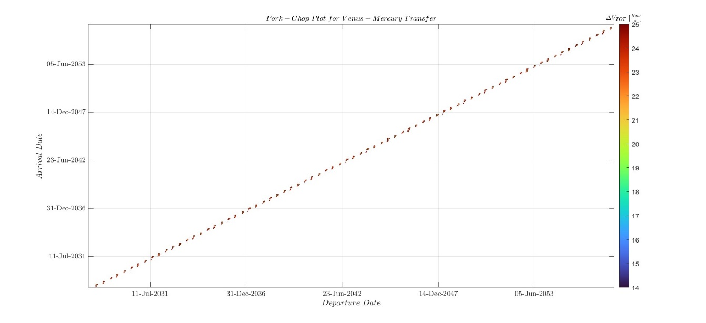
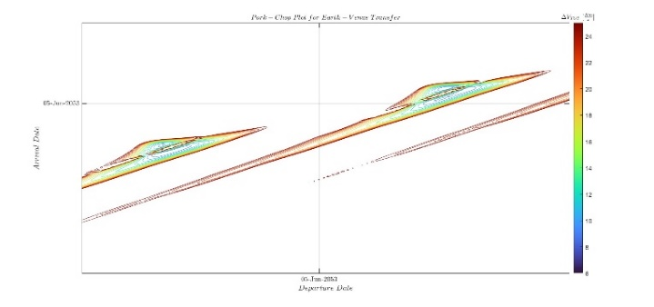
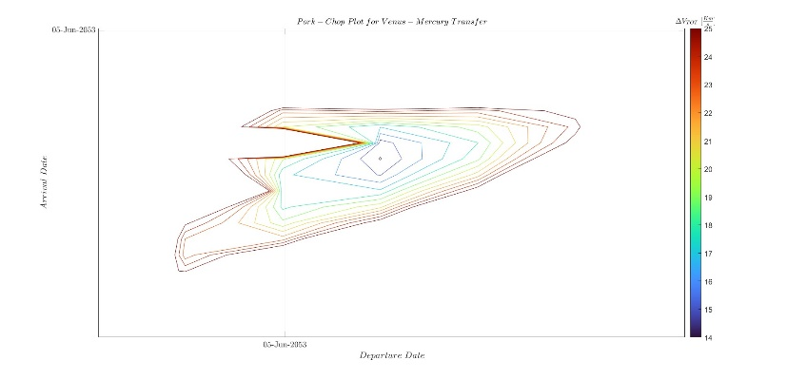
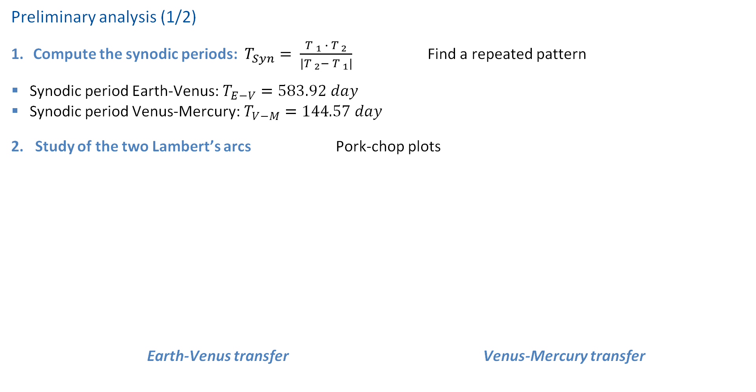
Interplanetary Explorer Mission
Preliminary analysis (1/2)
Compute the synodic periods: $T_{Syn}= \frac{{T }_{1} ∙ {T }_{2}}{{|T }_{2}− {T }_{1}|}$ Find a repeated pattern
Synodic period Earth-Venus:$T_{E−V}=583.92 day$
Synodic period Venus-Mercury:$T_{V−M}=144.57 day$
2. Study of the two Lambert’s arcs Pork-chop plots
Earth-Venus transfer Venus-Mercury transfer

Slide 6
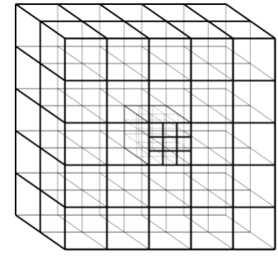
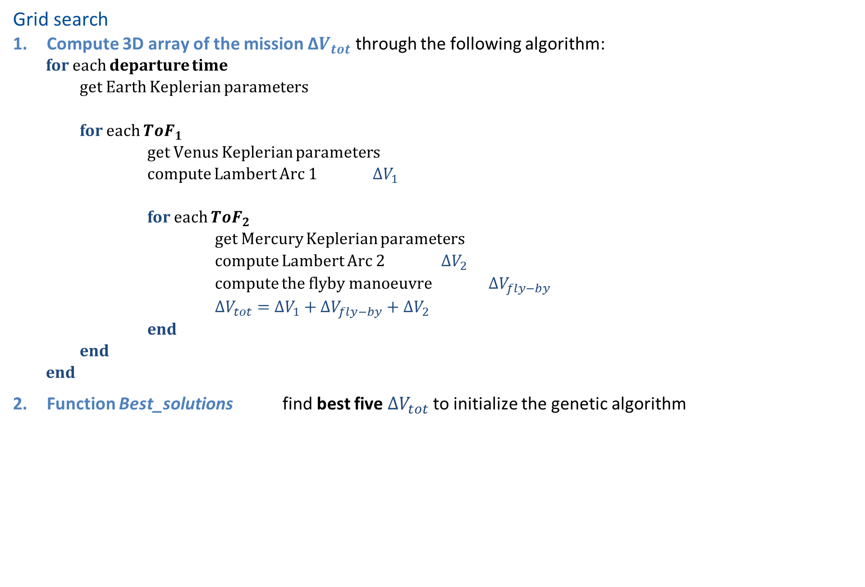



Interplanetary Explorer Mission
Grid search
Compute 3D array of the mission $\text{Δ}V_{tot}$ through the following algorithm:
for each departure time
get Earth Keplerian parameters
for each $ToF_{1}$
get Venus Keplerian parameters
compute Lambert Arc 1 $ΔV_{1}$
for each $ToF_{2}$
get Mercury Keplerian parameters
compute Lambert Arc 2 $ΔV_{2}$
compute the flyby manoeuvre$ΔV_{fly−by}$
$ΔV_{tot}=ΔV_{1}+ΔV_{fly−by}+ΔV_{2}$
end
end
end
Function Best_solutions find best five $ΔV_{tot}$to initialize the genetic algorithm
$${ToF}_{2}$$
$${ToF}_{1}$$
$$t_{dep}$$

Slide 7
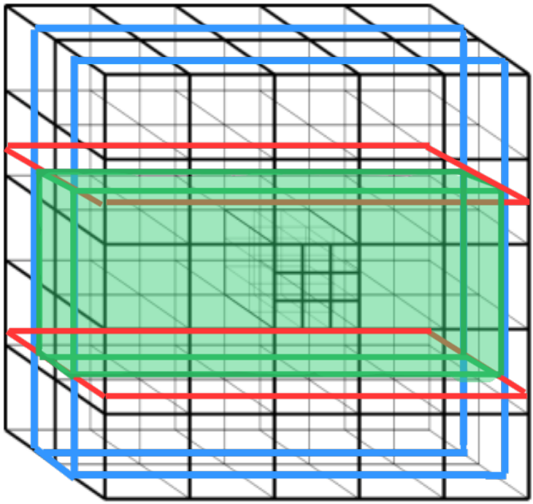

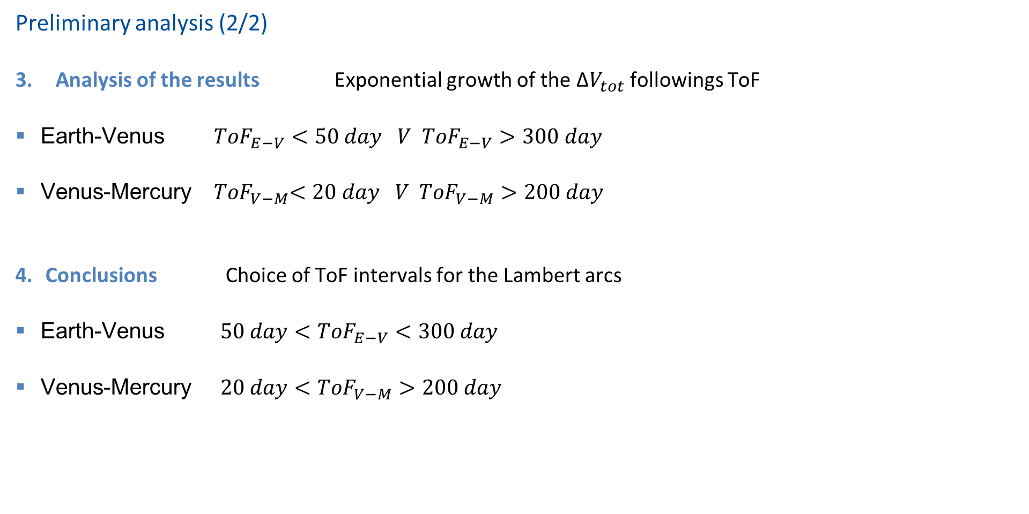


Interplanetary Explorer Mission
Preliminary analysis (2/2)
Analysis of the results Exponential growth of the $\text{Δ}V_{tot}$ followings ToF
Earth-Venus ${ToF}_{E−V}<50 day V {ToF}_{E−V}>300 day$
Venus-Mercury ${ ToF}_{V−M}<20 day V {ToF}_{V−M}>200 day$
Conclusions Choice of ToF intervals for the Lambert arcs
Earth-Venus $50 day<{ToF}_{E−V}<300 day$
Venus-Mercury $20 day<{ToF}_{V−M}>200 day$
$${ToF}_{2}$$
$${ToF}_{1}$$
$$t_{dep}$$

Slide 8
Interplanetary Explorer Mission
Genetic Algorithm (1/3) - Algorithm description
Start
Initialization
Initialization
1. Initialization:
Generate initial population of potential solutions.
2. Evaluation:
Evaluate fitness function for each individual in the population.
3. Selection:
Choose parents for the next generation based on fitness.
4. Crossover :
Exchange genetic information between parents.
5. Mutation:
Introduce random changes to offspring.
6. Termination:
Repeat steps for a set number of generations or until a stopping criterion is met.
7. Results:
Population evolves towards better fitness values since the algorithm terminate, giving the optimal individual.
Fitness function
Selection
Crossover
Mutation
Stop condition
no
yes
Final results

Slide 9
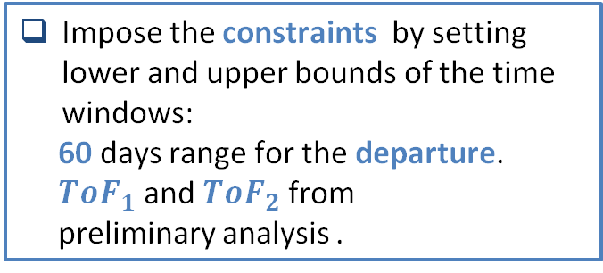
Interplanetary Explorer Mission
Genetic Algorithm (2/3) - First run and best solutions
Idea: Use the Matlab function ‘ga’, giving as inputs 3 time variables and a fitness function and as output the total $∆V$
Variables[day]: $t\left(1\right)=time from first possible departure t\left(2\right)=ToF_{Earth−Venus} t\left(3\right)=ToF_{Venus−Mercury}$
Design:
Setting the options for the first run:
Population size
Elite individuals
Stopping criteria
Creation of a fitness function with the outline already used in the ‘Grid Search’
Impose the constraints by setting lower and upper bounds of the time windows:
60 days range for the departure.
$ToF_{1}$ and $ToF_{2}$ from
preliminary analysis .
Run the program for each of the five solutions found from the ‘Grid Search’, and select the best result.

Slide 10
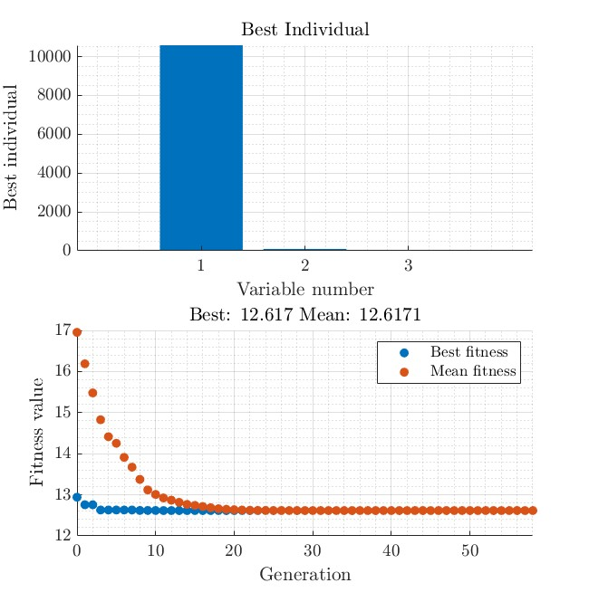

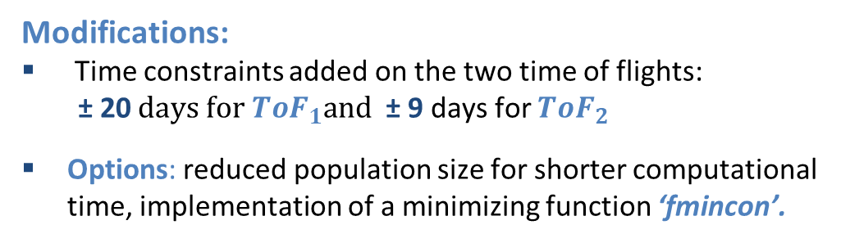
Interplanetary Explorer Mission
Genetic Algorithm (3/3) - Second run
Aim: Achieve a better precision for the best solution.
Modifications:
Time constraints added on the two time of flights:
± 20$days for ToF_{1}and$ ± 9 days for ${ToF}_{2}$
Options: reduced population size for shorter computational time, implementation of a minimizing function ‘fmincon’.
Results: The algorithm find the best individual associated to the $ΔV_{min}$ for each variable in mjd2000 [day].
Time from first possible departure [day] | Time of flight Earth-Venus [day] | Time of flight Venus-Mercury [day]
10584.941472 | 93.563069 | 48.857209

Slide 11
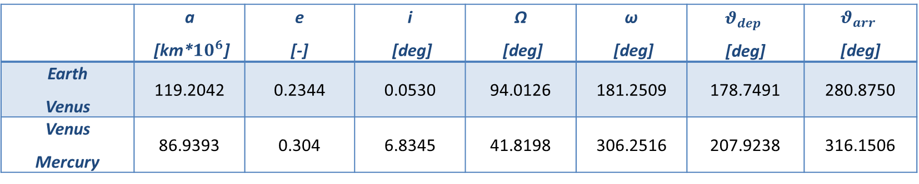

Interplanetary Explorer Mission
Mission analysis outputs (1/4) - Heliocentric trajectory
From the first possible departure date and the time results, the dates to perform the manoeuvres are computed.
DEPARTURE | FLYBY | ARRIVAL
December ${16}^{th}, 2057$ $$16:50:58$$ | March ${27}^{th}, 2057$ $$2:49:07$$ | May $5^{th}, 2057$ $$12:30:50$$
Now is also possible to fully characterize the two transfer arc.
 | a [km*${10}^{6}$] | e [-] | i [deg] | Ω [deg] | ω [deg] | $$θ_{dep}$$ [deg] | $$θ_{arr}$$ [deg]
Earth Venus | 119.2042 | 0.2344 | 0.0530 | 94.0126 | 181.2509 | 178.7491 | 280.8750
Venus Mercury | 86.9393 | 0.304 | 6.8345 | 41.8198 | 306.2516 | 207.9238 | 316.1506

Slide 12
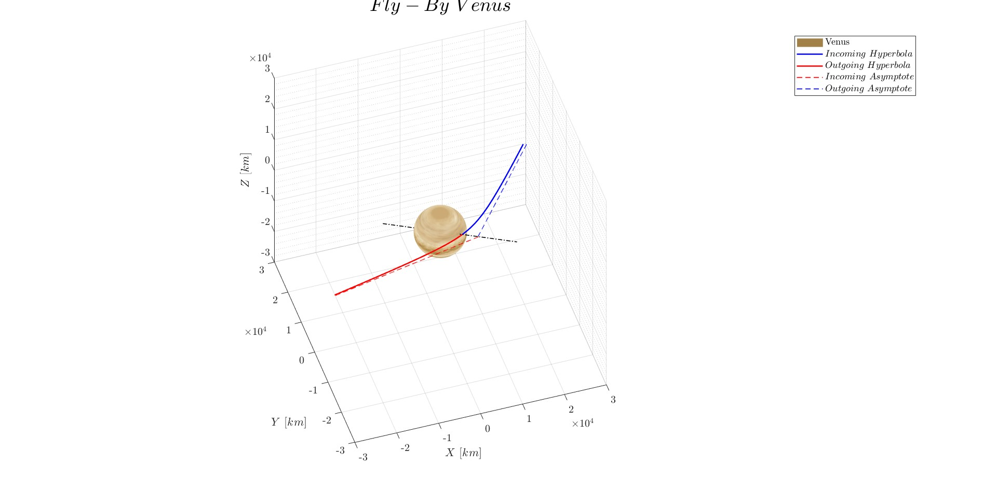
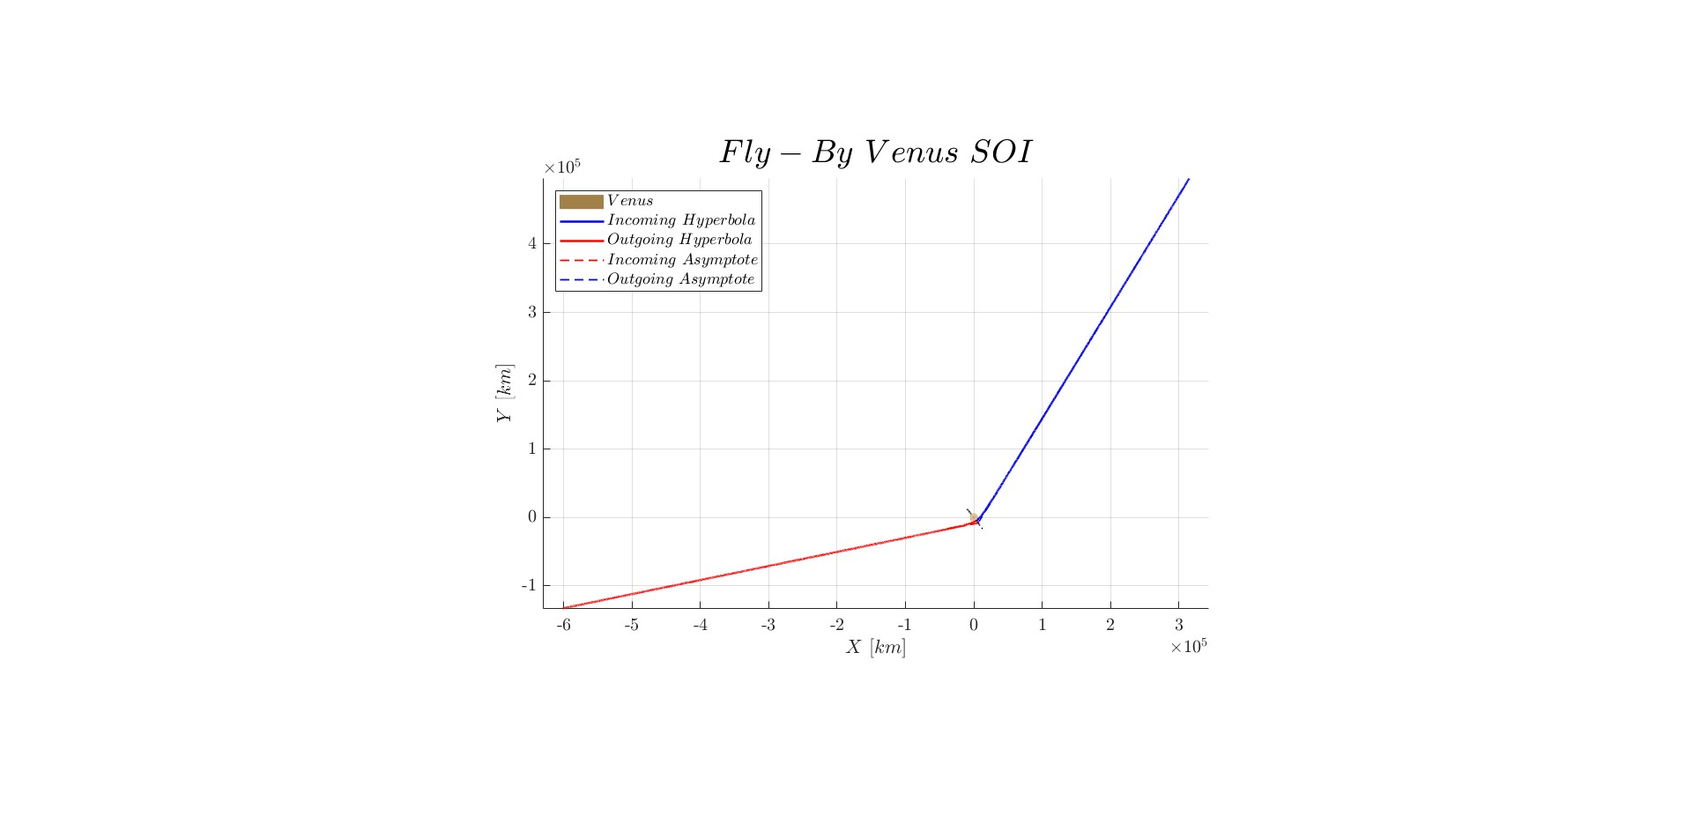
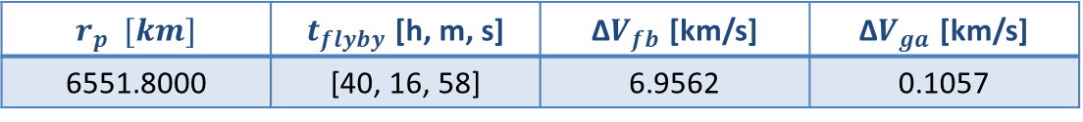
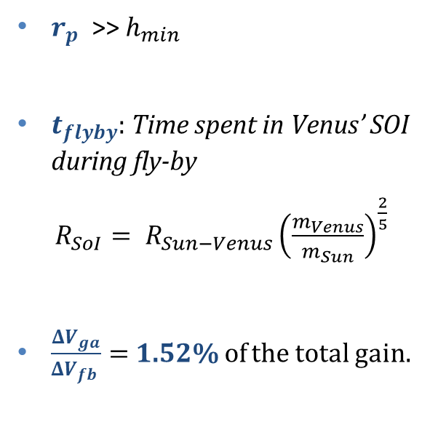
Interplanetary Explorer Mission
Mission analysis outputs (2/4) - Flyby (powered gravity assist)
$r_{p}$ $[km]$ | $t_{flyby}$ [h, m, s] | Δ$V_{fb}$ [km/s] | Δ$V_{ga}$ [km/s]
6551.8000 | [40, 16, 58] | 6.9562 | 0.1057
$r_{p}$ >> $h_{min}$
$t_{flyby}$: Time spent in Venus’ SOI during fly-by
$R_{SoI}= R_{Sun−Venus}{\left(\frac{m_{Venus}}{m_{Sun}}\right)}^{\frac{2}{5}}$
$\frac{ΔV_{ga}}{ΔV_{fb} }=$1.52% of the total gain.

Slide 13
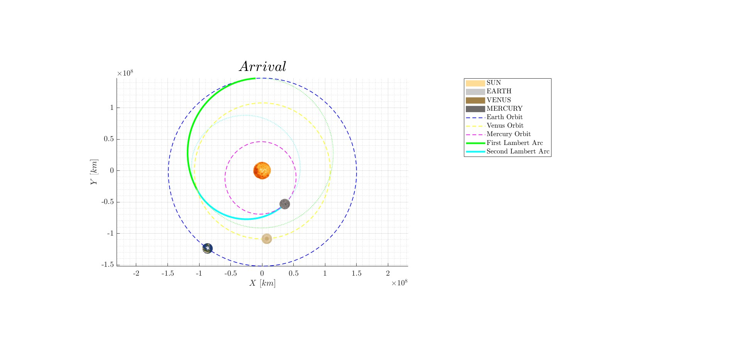
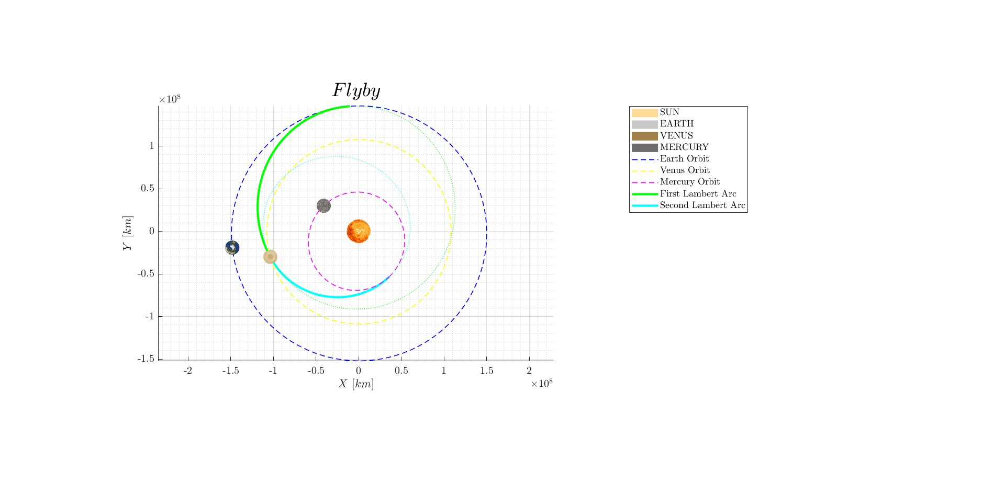
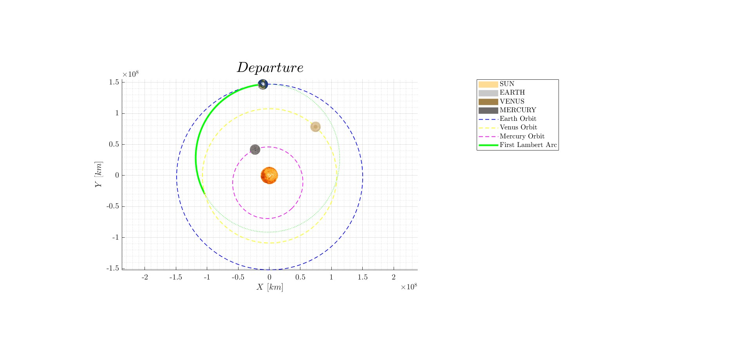
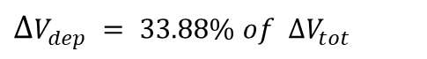
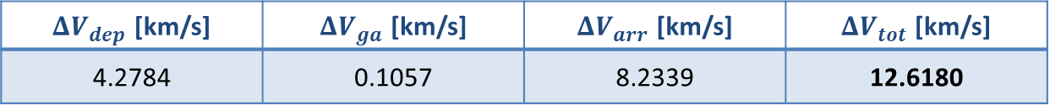
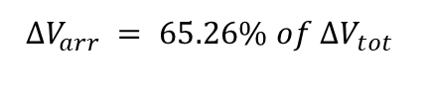
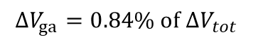
Interplanetary Explorer Mission
Mission analysis outputs (3/4) - Cost of the mission in terms of Δ$V_{tot}$
Δ$V_{tot}=$Δ$V_{dep}$ + Δ$V_{ga}$ + Δ$V_{arr}$
$ΔV_{dep}$ [km/s] | $ΔV_{ga}$ [km/s] | $ΔV_{arr}$ [km/s] | $ΔV_{tot}$ [km/s]
4.2784 | 0.1057 | 8.2339 | 12.6180
$ΔV_{dep} = 33.88\% of ΔV_{tot}$
$$ΔV_{ga}=0.84\% of ΔV_{tot}$$
$$ΔV_{arr} = 65.26\% of ΔV_{tot}$$

Slide 14
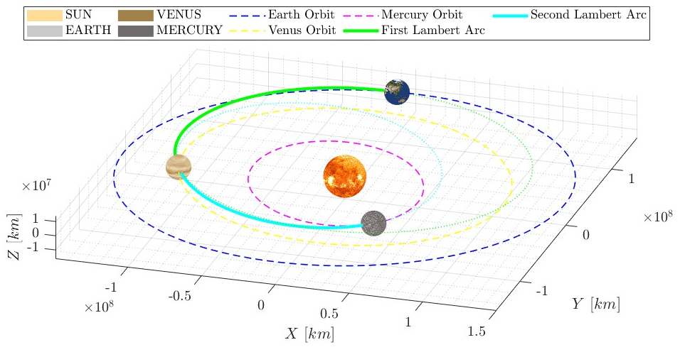
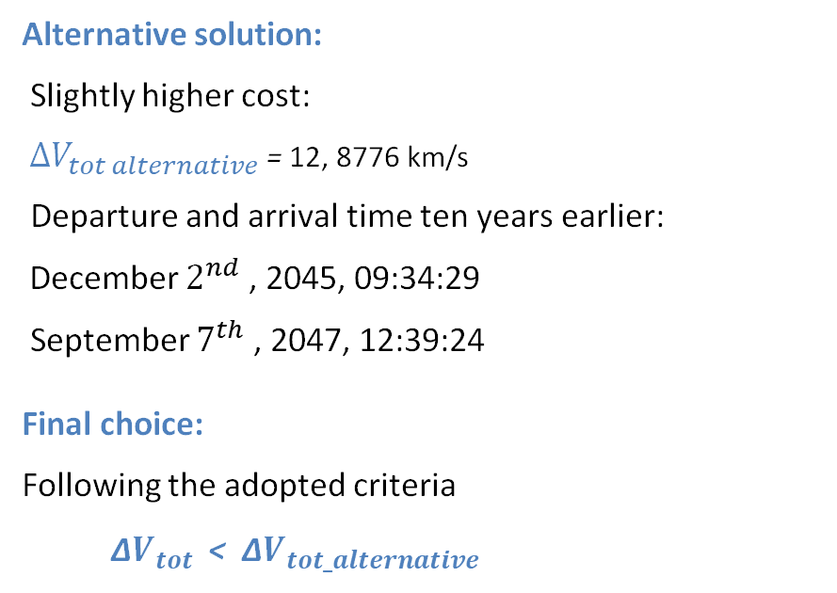
Interplanetary Explorer Mission
Mission analysis outputs (4/4) - Conclusion
Minimizing the total cost criteria
No constraints on the time windows.
Alternative solution:
Slightly higher cost:
$ΔV_{tot alternative}$ = 12, 8776 km/s
Departure and arrival time ten years earlier:
December $2^{nd}$ , 2045, 09:34:29
September $7^{th}$ , 2047, 12:39:24
Final choice:
Following the adopted criteria
Δ$V_{tot}$ < Δ$V_{tot_alternative}$

Slide 15
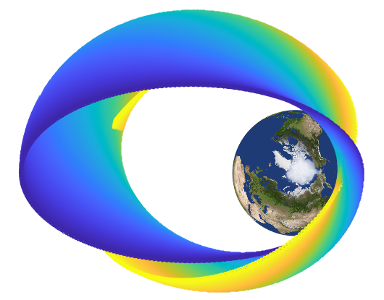
Assignment 2
PLANETARY EXPLORER MISSION

Slide 16
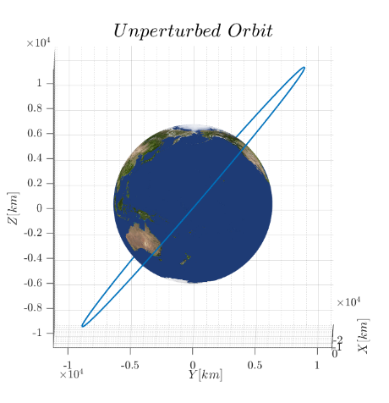
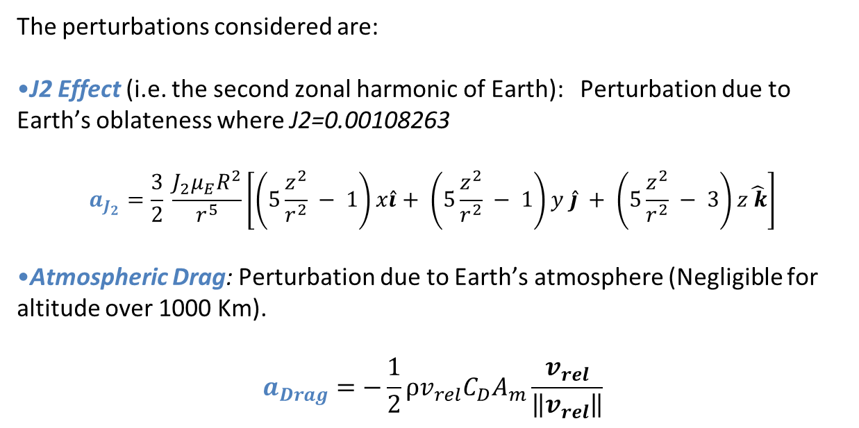
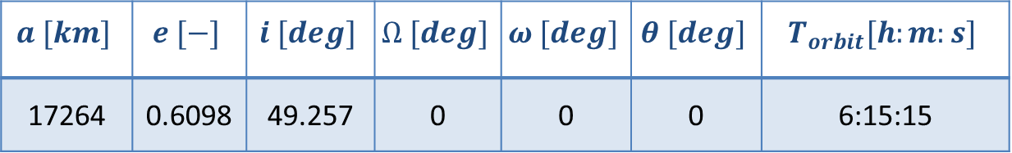
Planetary Explorer Mission
Nominal orbit
The perturbations considered are:
J2 Effect (i.e. the second zonal harmonic of Earth): Perturbation due to Earth’s oblateness where J2=0.00108263
$$a_{J_{2}}=\frac{3}{2} \frac{J_{2}μ_{E}R^{2}}{r^{5}}\left[\left(5\frac{z^{2}}{r^{2}} − 1\right)x\hat{i}+ \left(5\frac{z^{2}}{r^{2}} − 1\right)y \hat{j} + \left(5\frac{z^{2}}{r^{2}} − 3\right)z\hat{ k}\right]$$
Atmospheric Drag: Perturbation due to Earth’s atmosphere (Negligible for altitude over 1000 Km).
$$a_{Drag}=−\frac{1}{2}ρv_{rel}C_{D}A_{m}\frac{v_{rel}}{\left\|v_{rel}\right\|}$$
$$a [km]$$ | $$e [−]$$ | $$i [deg]$$ | $$Ω [deg]$$ | $$ω [deg]$$ | $$θ [deg]$$ | $$T_{orbit}[h:m:s]$$
17264 | 0.6098 | 49.257 | 0 | 0 | 0 | 6:15:15

Slide 17
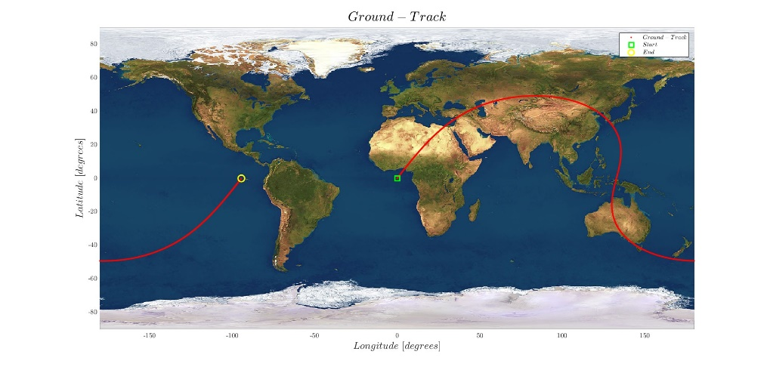
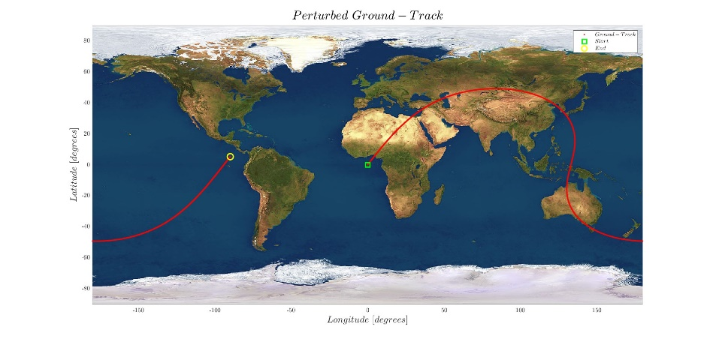
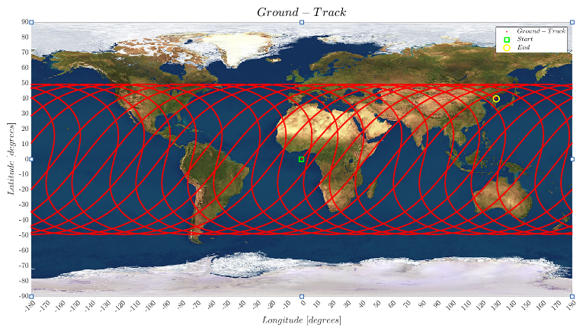

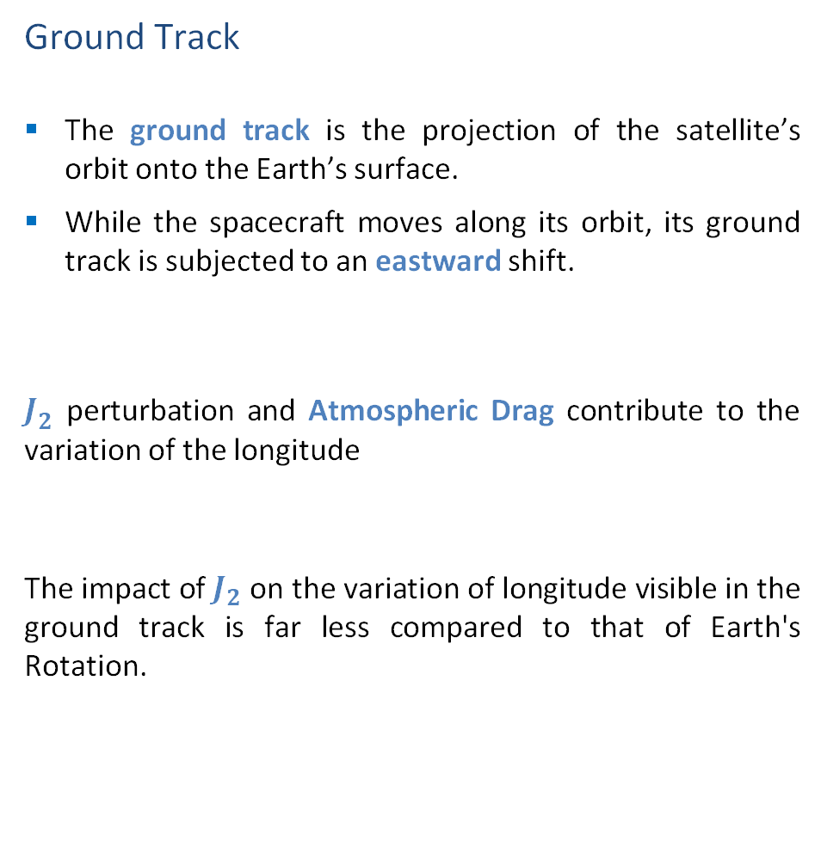
Planetary Explorer Mission
Ground Track
The ground track is the projection of the satellite’s orbit onto the Earth’s surface.
While the spacecraft moves along its orbit, its ground track is subjected to an eastward shift.
$J_{2}$ perturbation and Atmospheric Drag contribute to the variation of the longitude
The impact of $J_{2}$ on the variation of longitude visible in the ground track is far less compared to that of Earth's Rotation.

Slide 18
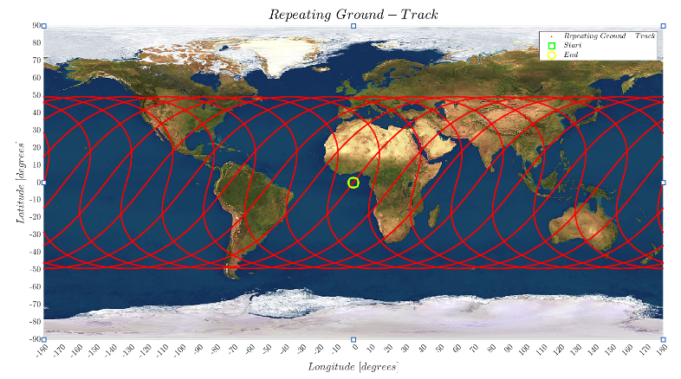
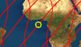
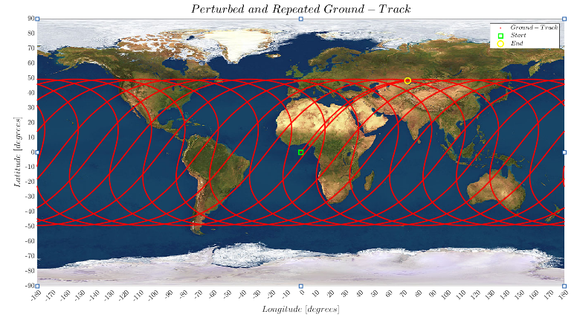
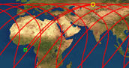
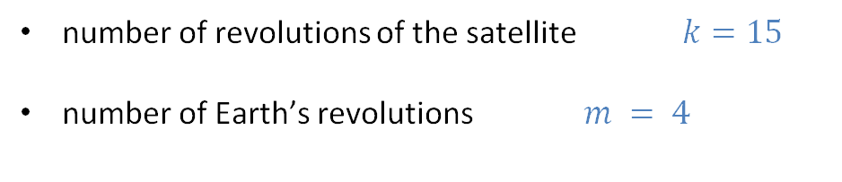

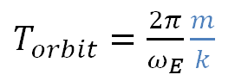
Planetary Explorer Mission
number of revolutions of the satellite $k=15$
number of Earth’s revolutions $m = 4$
Repeating ground track
ZOOM
$T_{orbit}=\frac{2π}{ω_{E}}\frac{m}{k}$
ZOOM
$$a_{mod}$$

Slide 19
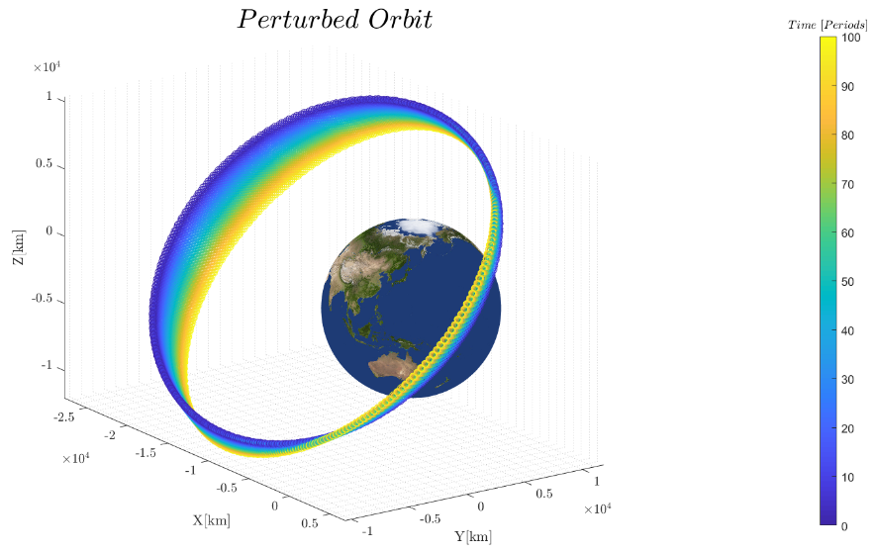
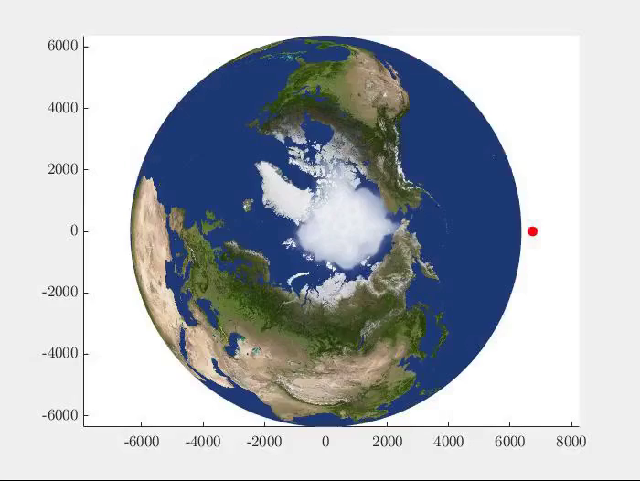
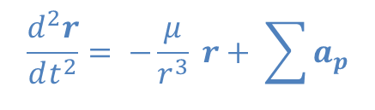
Planetary Explorer Mission
Orbit propagation
$$\frac{d^{2}r}{dt^{2}}= −\frac{μ}{r^{3}} r+ \sum{a_{p}}$$

Slide 20
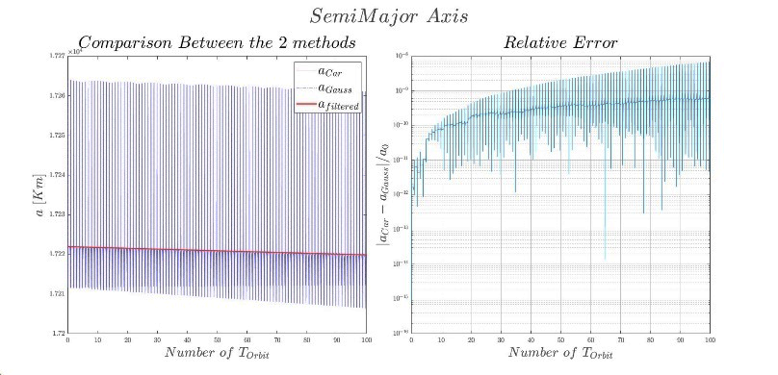
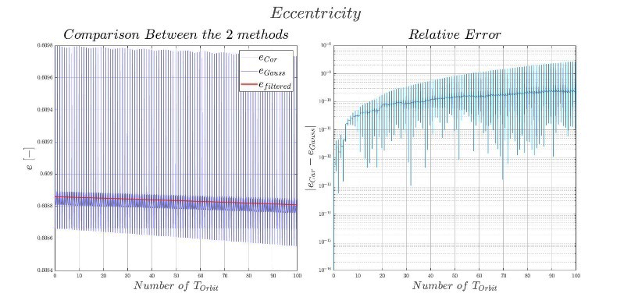


Planetary Explorer Mission
Gauss’s planetary equations: history of the Keplerian elements (1/3)
Due to Atmospheric drag
$$a$$
$$e$$

Slide 21
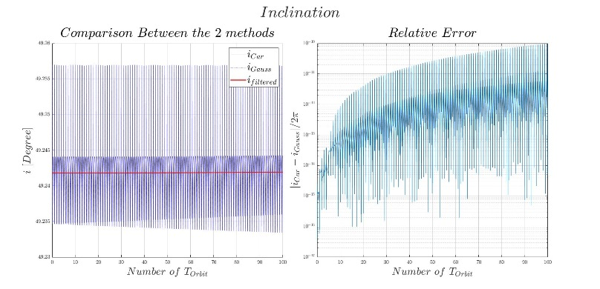
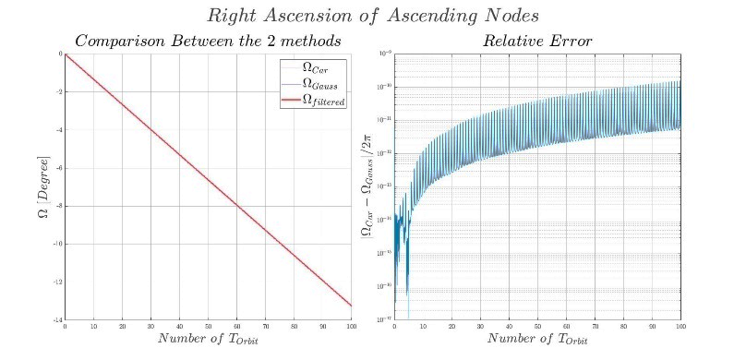



Planetary Explorer Mission
Gauss’s planetary equations: history of the Keplerian elements (2/3)
Due to $J_{2}$perturbation
$i$ remains constant
$$Ω$$

Slide 22
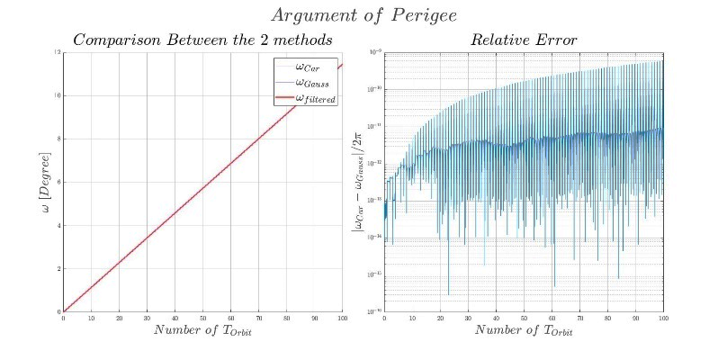




Planetary Explorer Mission
Gauss’s planetary equations: history of the Keplerian elements (3/3)
Due to $J_{2}$perturbation
$ω$
$θ$

Slide 23




Planetary Explorer Mission
Gauss equations and Cartesian Coordinates
Low pass filter
$$a_{sec} e_{sec} i_{sec}$$
movmean
Gibbs’ phenomenon mitigation
$${\dot{Ω}}_{sec} {\dot{ω}}_{sec} {\dot{θ}}_{sec}$$
Comparison
Relative error
Computational time
The relative error between the orbital parameters calculated with the two different approaches is approximately in the range of ${10}^{−10/−11}$
$$Gauss [s]$$ | $$Cartesian [s]$$
$$1.628831$$ | $$1.309231$$

Slide 24


Planetary Explorer Mission
Model Evaluation (1/2)
The selected celestial object is the Debris BREEZE-M DEB (TANK) (NORAD ID: 38344)
The choice of this celestial object is closely related to the perturbations affecting our original orbit.
$$a [km]$$ | $$e [−]$$ | $$i [deg]$$ | $$Ω [deg]$$ | $$ω [deg]$$ | $$θ [deg]$$ | $$T_{orbit}[h:m:s]$$ | $$r_{p} [km]$$
17833 | 0,6221 | 49,429 | 50,604 | 217,812 | 194,12 | 6:15:15 | 363,9

Slide 25

Planetary Explorer Mission
Model Evaluation (2/2)
Gauss equations
Small error
Efficient model

Slide 26
Thank you for your attention!

